Slide 1

Mergers-Acquisitions-Affiliations-Collaborations -
Coming together to create opportunity

Slide 2
Webster Definitions
Merger
-absorption by a corporation of one or more others; also : any of various methods of combining two or more organizations (as business concerns).
A merger can be further defined as a process that results in the lead nonprofit corporation becoming legally responsible for the assets and liabilities of the acquired nonprofit. The term “merger” also refers to those rarer instances in which at least two nonprofit corporations dissolve in order to form one new nonprofit corporation.

Slide 3
Webster Definitions
Acquisition
something or someone acquired or gained
<the team announced two new acquisitions>

Slide 4
Webster Definitions
AFFILIATION
-To become closely connected or associated. To adopt or accept as a member, subordinate associate, or branch

Slide 5
Webster Definitions
Collaboration
-to cooperate with an agency or instrumentality with which one is not immediately connected

Slide 6

Coming together-The merger

Slide 7
Reasons for Merging
Economic Downturn: Guidestar estimates nearly 30,000 nonprofits in eminent danger of having to shut down.
No hard figures, but anecdotal evidence suggests that hundreds of nonprofits are merging in the US each year.
Main Reasons
Economic downturn, leadership issues, lack of need for services, overlap or duplication of services.

Slide 8
Rubber meets the road
http://vimeo.com/20262598
An insightful video of successful nonprofit mergers and acquisitions

Slide 9

Timeline: History of
IBS-FWI Merger
2009- Discussions begin at BOARD and Executive Level: A casual conversation on the way to a conference.
Contributing Factors:
Board Chair of IBS has business relationship with ED of FWI
Board Chair of FWI business savvy, not tied to tradition

Slide 10

Timeline: History of
IBS-FWI Merger
early 2010- a small group, both board chairs and CEO’s meet over breakfast to talk/dream/plan.
Summer 2010-a consulting firm hired that had history and trust of both agencies to facilitate.

Slide 11
Timeline: History of
IBS-FWI Merger
Fall 2010- steering committee formed. Very careful selection of 2 members from each board.
Steering Committee initial stance:
Commitment to agencIES
Skeptical of merger
Leadership Decides that it is Critical that these members agree that merger is right thing before bringing to full board.

Slide 12
Timeline: History of
IBS-FWI Merger
Winter 2011- steering committee, with support from consultants begins work on financial analysis, cultural issues, business opportunities, SWOT
Late winter 2011- FINANCIAL/BUSINESS report presented to both Boards.
Both Boards sign non binding agreement to merge/AFFILIATE if due diligence report (LEGAL) affirmative.
Top management of both agencies get together for a 3 day retreat to begin the organizational/operation planning.

Slide 13
Timeline: History of
IBS-FWI Merger
Spring 2011- major funders notified of non binding agreement.
funding source found to cover cost of due diligence.
Begin work on executive succession plan and organizational chart.
Attorney SELECTED. begins the discover process in spring. Produces a due diligence report that exposed all of the strengths and weaknesses, as well as pending litigation other potential liabilities.
Marketing firm hired to work with focus group to create logo, tagline, and marketing plan.

Slide 14
L0G0-TAGLINE

Slide 15
LEGAL FRAMEWORK
NOT REALLY A MERGER-TRUE MERGERS ARE RARE
“ASSET TRANSFER AND AFFILIATION AGREEMENT”
Substantially all assets of fwi to ibs
Ibs corporate structure remains as primary organizing unit
Fwi maintains corporate status in order to accommodate future community employment program
Rebranding-renaming strategy

Slide 16
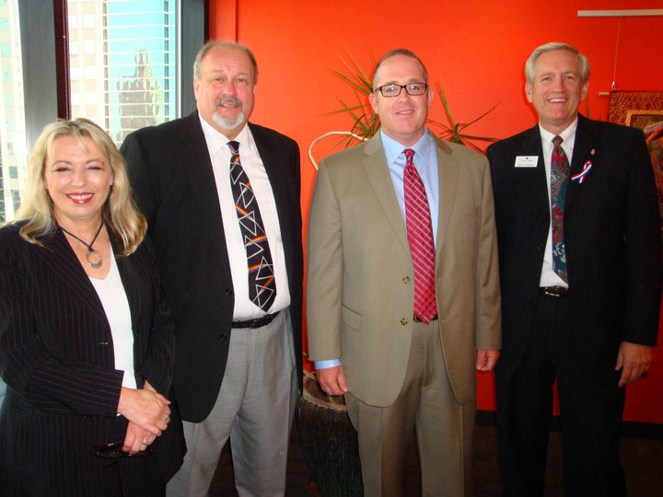
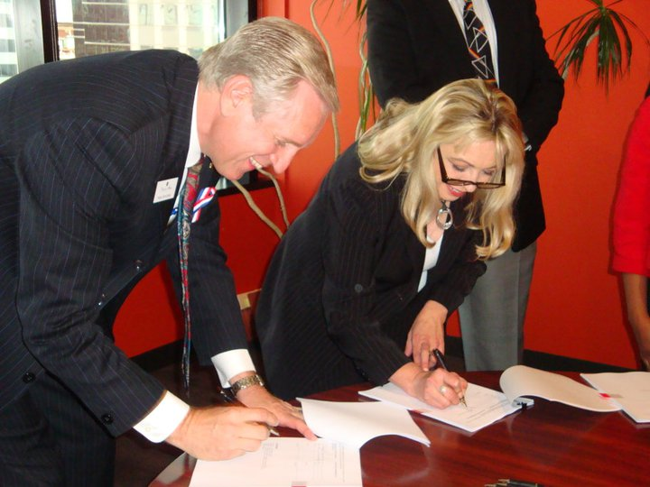
Timeline: History of
IBS-FWI Merger
July 1, 2011
AFFILIATION AND ASSET TRANSFER
agreement signed

Slide 17
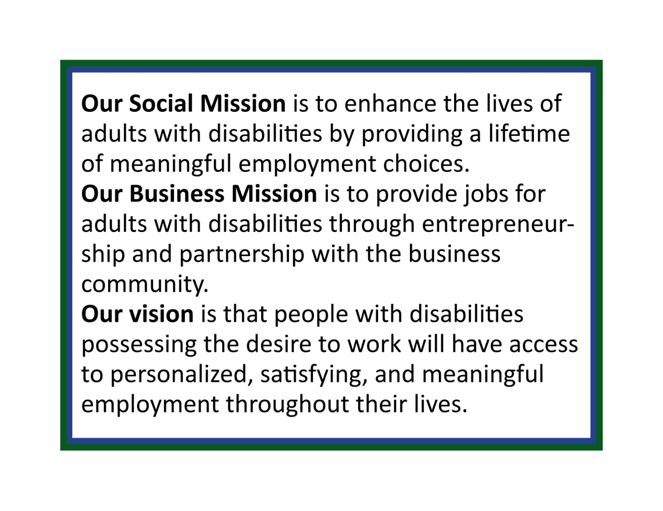
Our New Mission-Vision

Slide 18
Why Was the Merger Successful?
-Engagement of consulting firm
-Both agencies willingness to plan for future, leave egos at door, and act in manner in best interest of employees.
-Progressive, forward thinking board leadership.
-Outside funding sources
-Communication and input from stakeholders (town halls, surveys)
-Top notch legal representation
-Support from funders
- CEO of IBS vision
-Executive Succession plan-leadership transition
-Rebranding and repositioning
-pr value-marketing

Slide 19

What Could Have Been Done Better in Hindsight?
-exploration of cultural differences
-allow more time for legal work to be completed
-More thorough and in-depth strategic and business planning
-Budgeting
-staff personnel
Policies
-Communication

Slide 20
JobOne Merger Has Been a Success
-Entrepreneurial energy
-Capital to expand services, purchase equipment
-Fundraising and development
-Rebranding
-influence: SB 40 board
-Very little duplication. Leaner and more responsive administration

Slide 21
Sheltered Workshops in Missouri and Mergers
-Already a good deal of communication and common interest (DESE, MASWM)
-Workshops are in a position to be entrepreneurial and progressive….ubit issues are minimal, possibilities endless
-Funding sources likely supportive of efforts to improve services
-Opportunities exist to diversify, create new businesses
-Lack of work-aggressive and progressive marketing

Slide 22
Sheltered Workshops in Missouri and Mergers
-Lack of business development acumen or desire in many workshop corps
-Political and regulatory pressure-larger agencies might exert more power and influence
-Decrease Overhead costs over time
-Better performing, more competent boards
-Duplication of services
-Coordinated transportation

Slide 23

Questions or Comments?
Contact us:
Stan Shurmantine
CEO
sshurmantine@job1one.org
Aaron Martin
Executive Director
amartin@job1one.org

